Slide 1
Citi Bike Data Analysis
By Ramlan Apriyansyah

Slide 2
Project Goal:
To better understand the behavior of Citi Bike’s customer base (both one-time users and subscribers) and how they use Citi Bikes
This will help us to:
Identify where more bikes should be installed
Create targeted marketing campaigns that will appeal to different customer segments

Slide 3
Key questions:
What are the most popular pick-up locations across the city for Citi Bike rental?
How does the average trip duration vary across different age groups?
Which age group rents the most bikes?
How does bike rental vary across the two user groups (one-time users vs long-term subscribers) on different days of the week?

Slide 4
Findings & Insights

Slide 5
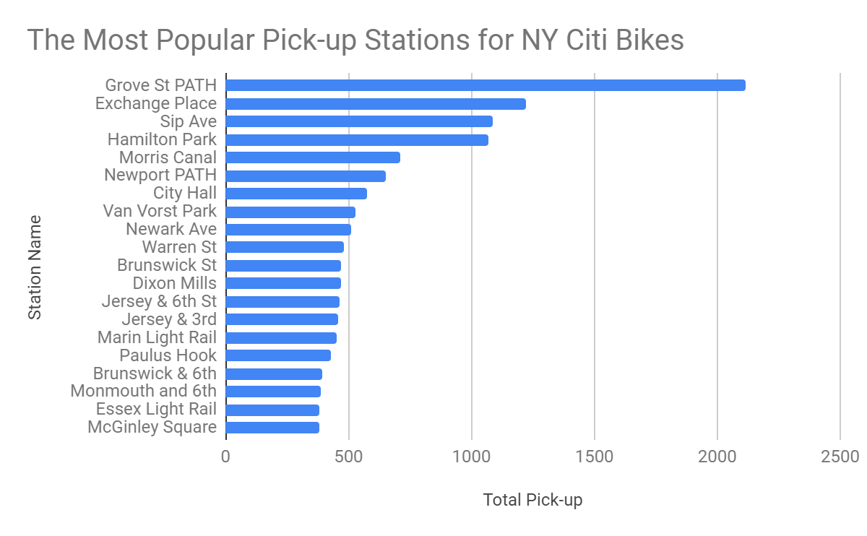
What are the most popular Citi Bike pick-up locations?
Grove St PATH is the most popular pick-up location with more than 2000 total pick-up.

Slide 6
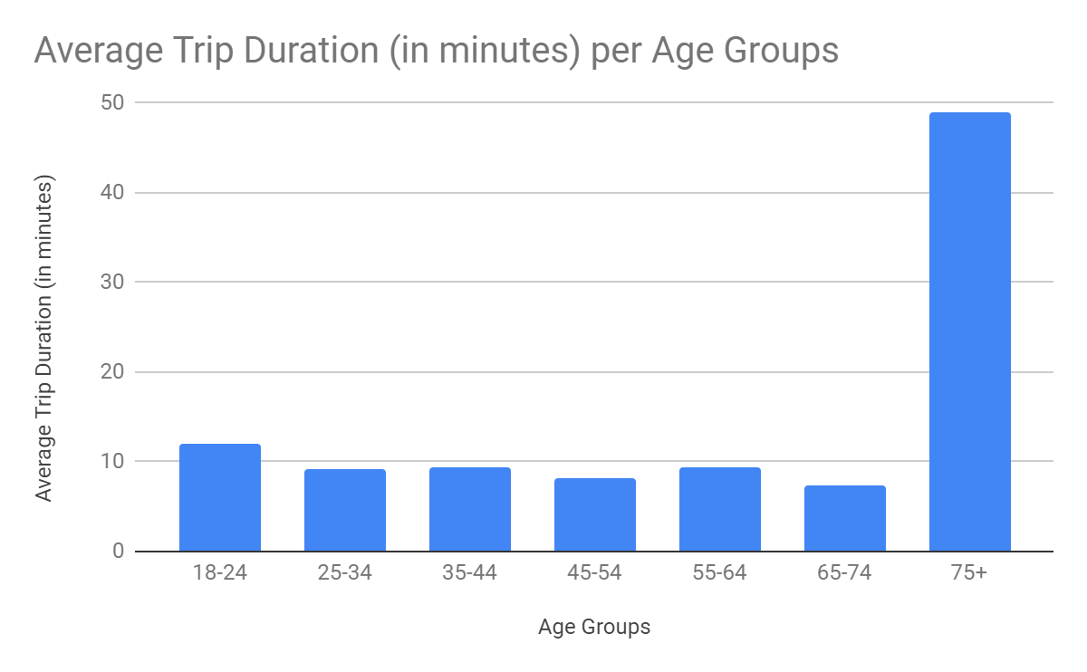
2. How does the average trip duration vary across different age groups?
Users in 75+ age group have the longest average trip duration.
They took approximately 50 minutes per trip.

Slide 7
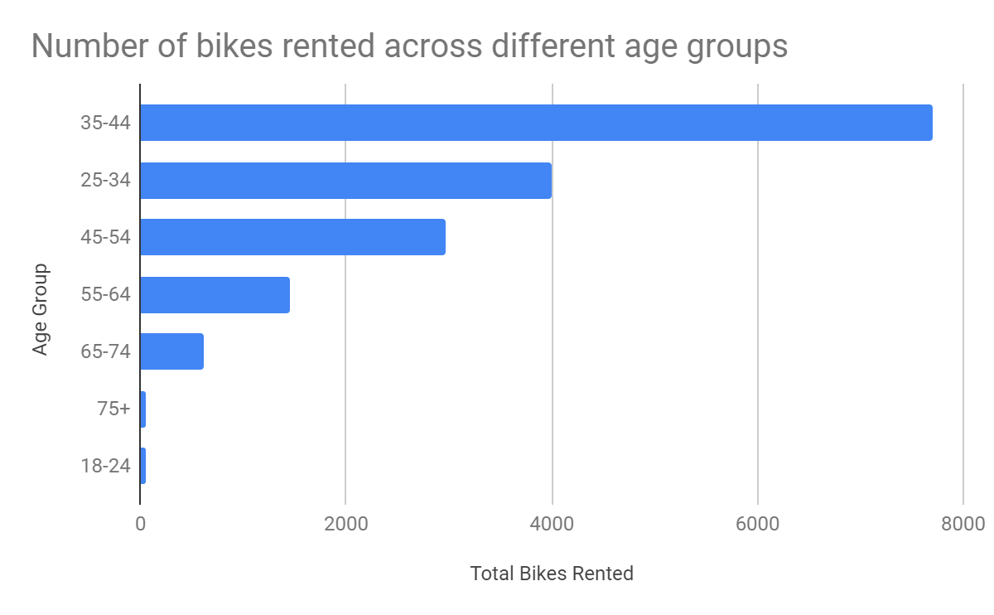
3. Which age group rents the most bikes?
Most users who rent bikes are in age between 35-44 years old.

Slide 8
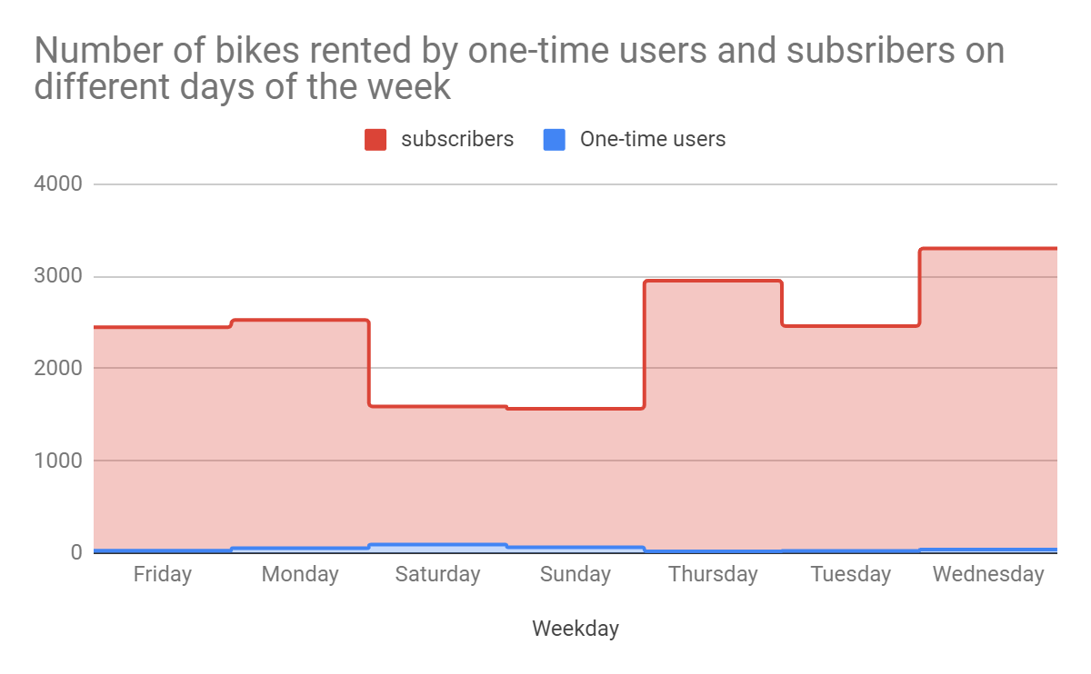
4. How does bike rental vary across the two user groups (one-time users vs long-term subscribers) on different days of the week?
Most subscribers rent bike on weekdays, while one-time users mostly rent on weekends.

Slide 9
Summary

Slide 10
Summary of findings:
Top 5 pick-up locations for bikes:
Grove St Path, Exchange Place, Sip Ave, Hamilton Park, & Morris Canal
Customer base:
Most of Citi Bike’s customers are in age between 35-44, and most of them are subscribers of Citi Bike.
Citi Bike customer behavior:
Users over 75 years of age have the longest trip, while customers age 65-74 have the shortest one.

Slide 11
Actions & Recommendations

Slide 12
Recommended actions:
Product recommendations:
Install more bikes at Grove St Path, Exchange Place, Sip Ave, Hamilton Park, & Morris Canal
Marketing recommendations:
The Citi Bike customer base is mostly subscribers aged between 35-44 years-old, who are most active on the weekdays.. This tells us that they are probably people who live in New York and use Citi Bikes to commute. Marketing and advertising campaigns should therefore target this particular demographic.

Slide 13
Thank you!

